Slide 1

Design Pattern
Search
State
Truong Dang Minh Khue

Slide 2
Definition
allows object to alter its behavior when its internal state changes.
State Pattern

Slide 3

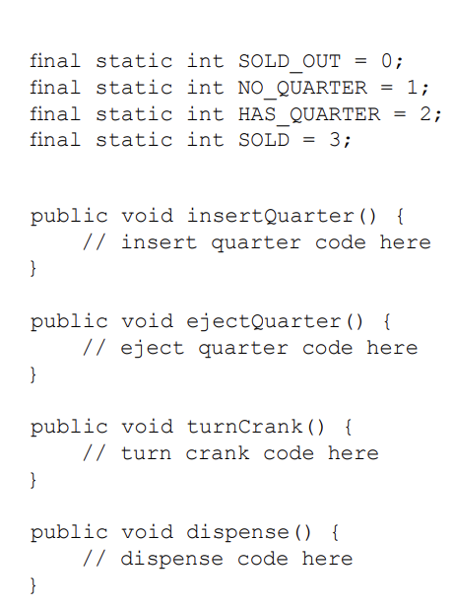
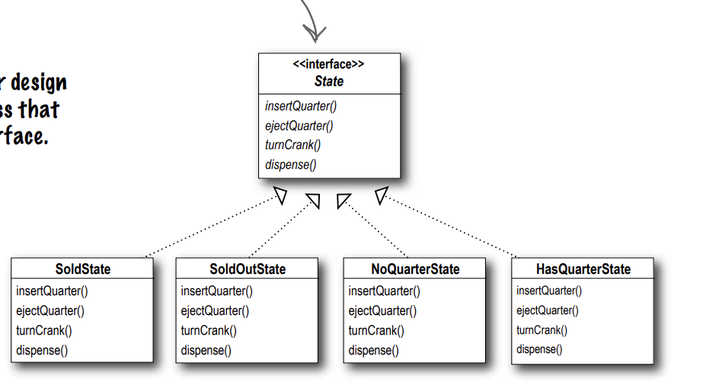


Slide 4


 | Notes
 | when using the state pattern
1
2
3
The State Pattern allows an object to have many different behaviors that are based on its internal state. | The State and Strategy Patterns have the same class diagram, but they differ in intent. | Using the State Pattern will typically result in a greater number of classes in your design

Slide 5
Thank you!
Until our next design pattern!

